Slide 1

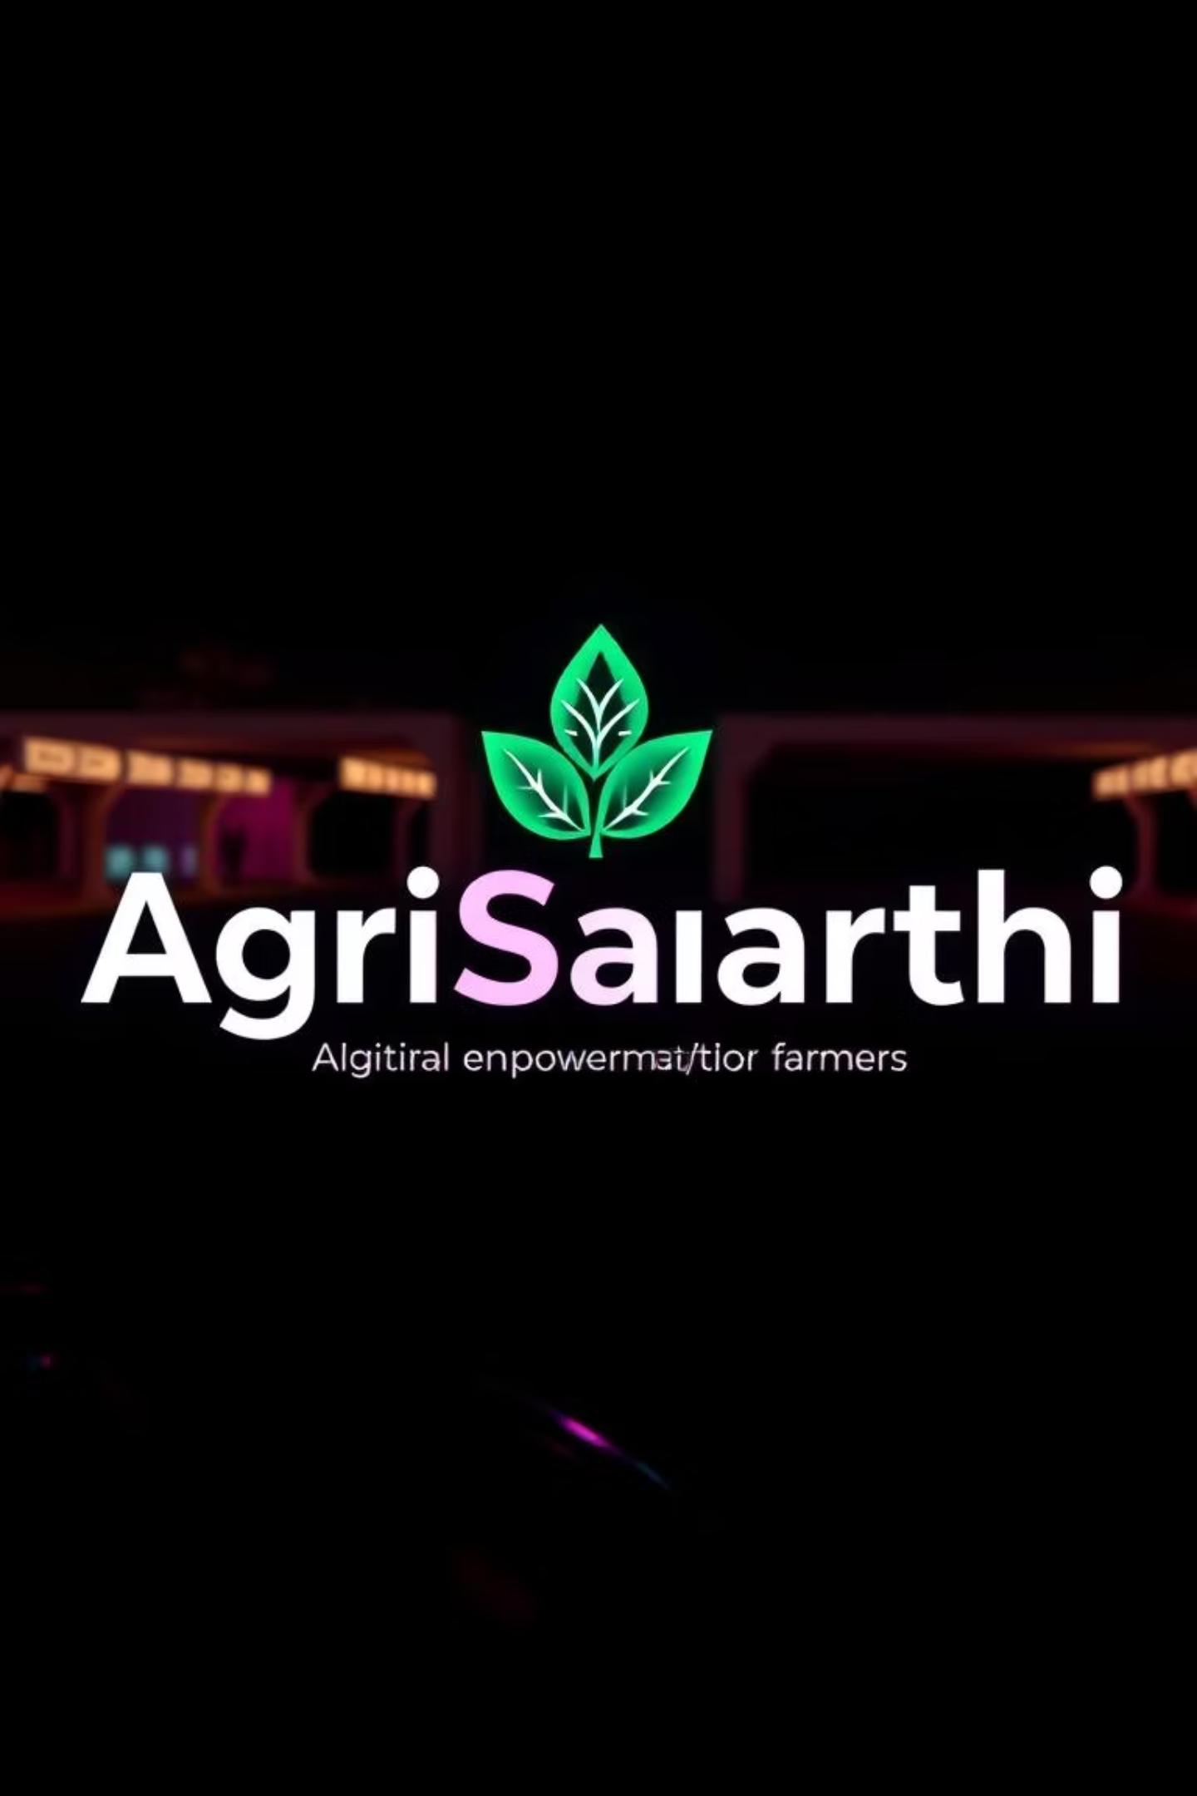

AgriSaarthi – Empowering Farmers Digitally
Prepared by: BHATT MAHARSHI JIGNESHBHAI
Enrollment No.: 23002170110010
Roll No.: 147
Batch:A5
Branch: C.E.

Slide 2
Introduction
What is AgriSaarthi?
Purpose
Target Users
AgriSaarthi is a digital platform designed to support farmers. It serves as a comprehensive resource for agricultural information and community interaction.
The platform's primary purpose is to provide farmers with easy access to informative blogs and verified government schemes, fostering a more connected and informed agricultural community.
Farmers
Experts
Government Officials
Retailers
Made with ❤️ for Rural India

Slide 3



Problem Statement
Lack of Centralized Digital Platforms
Difficulty in Accessing Government Schemes
No Digital Community for Farmers
Farmers often struggle to find a single, reliable digital hub for all their agricultural needs, leading to fragmented information access.
Information about crucial government schemes is often scattered or complex, making it hard for farmers to identify and apply for relevant support.
There's a significant gap in digital spaces where farmers can interact, share knowledge, and learn from each other's experiences.
Made with ❤️ for Rural India

Slide 4





Objectives
Help farmers access verified government schemes
To provide a reliable and easy-to-navigate database of government agricultural schemes.
Allow farmers and experts to post informative blogs and media
To create a platform for knowledge sharing through user-generated content.
Encourage community engagement
To foster a vibrant online community where farmers can interact, ask questions, and share experiences.
Weather Prediction
To provide accurate and timely weather forecasts relevant to agricultural activities.
Market Price Analysis
To offer insights into current market prices for various crops, aiding farmers in making informed selling decisions.
Made with ❤️ for Rural India

Slide 5





Tech Stack
Frontend: React.js
Backend: Django (Python)
Database: SQLite
Utilizing React.js for building a dynamic and responsive user interface.
Using SQLite for efficient and lightweight data storage and retrieval.
Leveraging Django for robust backend development, API management, and data processing.
Framework: Bootstrap
Icons: Font Awesome
Implementing Bootstrap for responsive design and consistent UI elements.
Integrating Font Awesome for a wide range of scalable vector icons.
Made with ❤️ for Rural India

Slide 6
System Features
Blog System
Image Upload in Posts
WEATHER PREDICTION
Market analysis
Role-Based Access
Made with ❤️ for Rural India

Slide 7





Architecture Diagram
Backend
Auth, Posts, Schemes
Frontend
API Services
Made with ❤️ for Rural India
This diagram illustrates the flow of data and interactions within the AgriSaarthi platform, from user interface to backend services and API management.

Slide 8

Key Challenges
Handling media uploads and poll data together
Managing user roles and permissions cleanly
Integrating diverse data types like media files and poll responses within a unified system.
Ensuring a robust and secure system for different user roles with varying access levels.
Realtime market data fetching
Realtime Govt. schemes data fetching
Implementing efficient mechanisms to fetch and display up-to-date market prices.
Developing reliable methods to continuously update and verify government scheme information.
Made with ❤️ for Rural India

Slide 9



Future Enhancements
Offline accessibility (PWA)
Notification system for scheme deadlines
To enable farmers to access essential information even without an internet connection, through a Progressive Web App.
Add support for regional languages
To alert farmers about important deadlines for government schemes, ensuring they don't miss out on opportunities.
To make the platform accessible and user-friendly for farmers across diverse linguistic backgrounds.
Made with ❤️ for Rural India

Slide 10
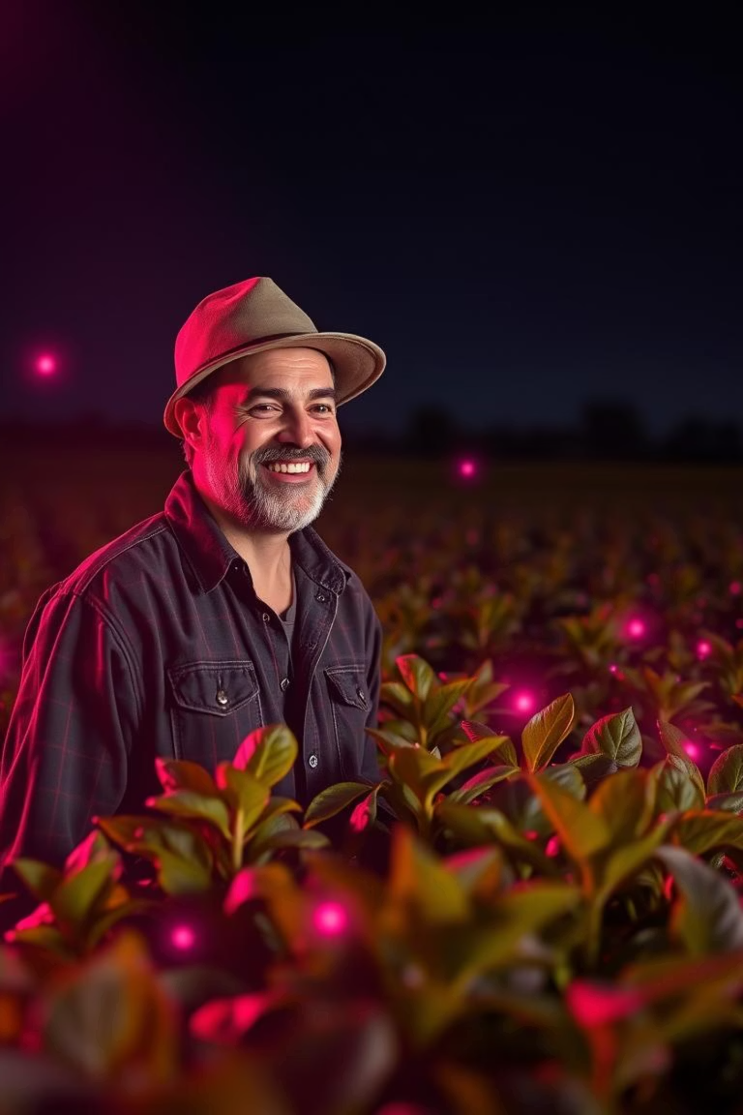
Thank You!
Made with ❤️ for Rural India

